Slide 1
DIY PROJECT
Team -10
Project 6

Slide 2
Index
Project assigned
Team member and their roles
Components and their technical specifications
Plan of action
Progress per week
Work done by each team member
Schematic and circuit view of project
Final code
What we could have achieved and what was left out.

Slide 3
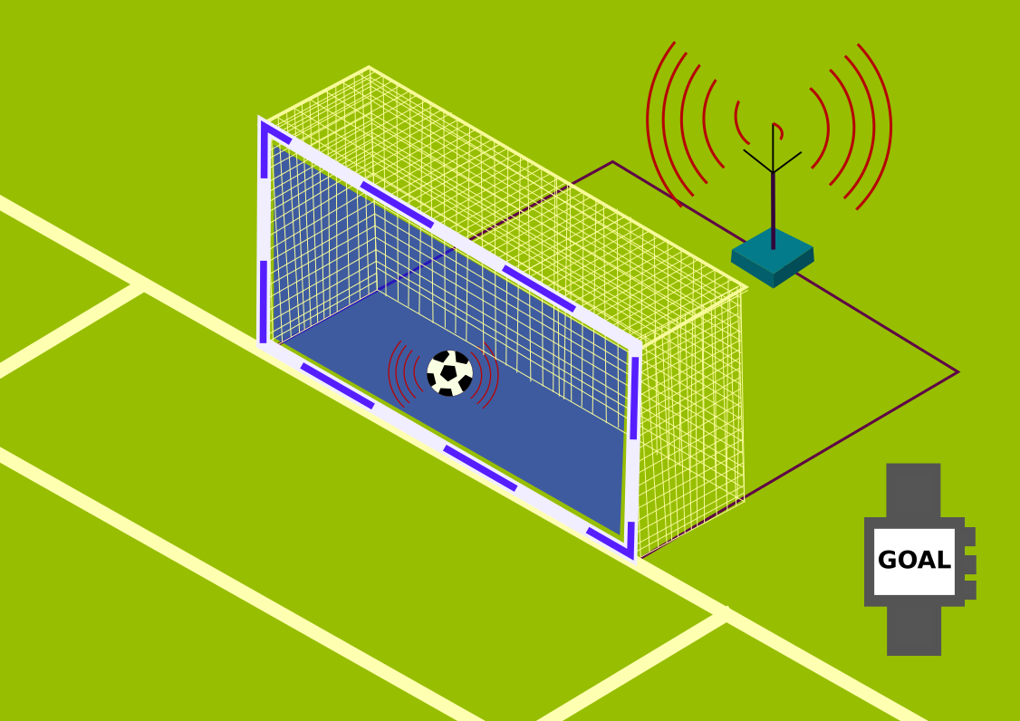
Project Assigned
Hey…….was that a goal..??
Computer Vision Based
System that will track the motion
of a moving object , and a signal will
be given when the object crosses
the line completely.
Yes !!….the sensor indicates..

Slide 4
Team Members And Roles
Tanish Goel- Hardware
Ayush Agrawal-Software and Design
Yuvraj Gandhi-Software and coordination
Gagan Meena-Software and Design

Slide 5
COMPONENTS
S.No | Part Name | Quantity | Cost(Rs.)
1. | Arduino Uno | 1 | 660
2. | PIR Sensor | 1 | 318
3. | Ultrasonic Sensor | 1 | 223
4. | Breadboard | 1 | 368
5. | Jumper Wires
6. | BUZZER | 1 | 40
7. | LED | 1 | 115
The final cost of the project came out to be Rs. 1724 ( Ordered from Amazon ( online retailer))

Slide 6
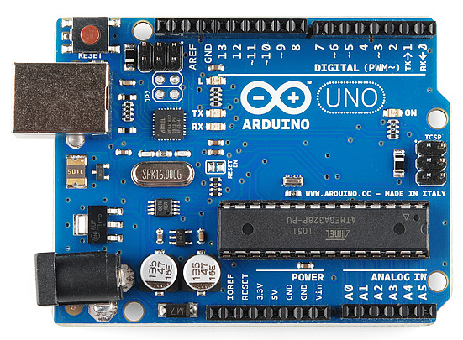
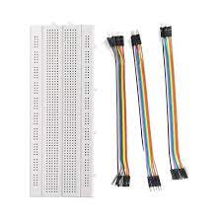
Part Technical Specifications
1]. Arduino Uno R3.
ATmega328P based microcontroller
Operating voltage of 5V
Conprises of 14 -digit l/O pins
2]. Breadboard & jumper wires.
Withstanding voltage is 1,000V AC
Insulation resistance : DC 500V or 500M ohm

Slide 7
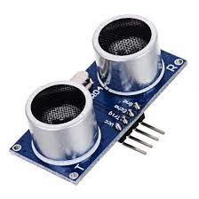
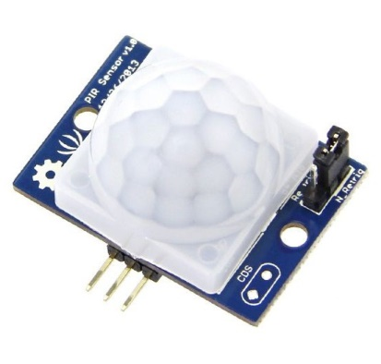
About The Two Sensors used
3]. PIR Sensor
Senses infrared signal emitted by various objects.
Sensing range is about 7 metres ( 100 degree cone)
Input voltage : DC 4.5-20 volts
Level output : High 3.3V / Low 0V
4]. Ultrasonic Sensor
Measures distance through ultrasound which travels through the air.
Ranging distance : 2cm-4m
Power supply : DC 5V
Operating current : 8mA
Working frequency : 40Hz

Slide 8
Plan Of Action
Assemble the circuit when we receive the components.
We will be using ultrasonic sensor and pir sensor at first to detect the object.
Ultrasonic sensor, uses ultrasonic rays to detect the object and can also tell the distance. It is usually used in radar systems
PIR sensor uses heat signals to detect the object , hence a point over ultrasonic sensor, which cannot detect soft objects.
After we are done with these two, we will try to add camera and using machine learning , the system can be more accurate.
We can also use screen to show distance between the line and the object.

Slide 9
Progress per week
Week 1
Understanding the aim of the project and discussing the plan of action.
Making the list of the components required.
Ordered the components online
Assigned the roles for each team member.
Week 2
Received the components.
Started the coding part for both the sensors.
Made a sample hardware to check the working of the components.
Discussion about involving camera/screen in the project

Slide 10
.
Week 3.
Completed the coding part for each sensor .
Combined both the code and made the final code.
Designed the final hardware as per the circuit made in the tinkercad.
Tested the working of the hardware using the final code.
Week 4.
Arranged the hardware model with the sensors in a suitable positions for the goal line technology.
Tested the model with soft as well as hard objets (eg: paperball , season ball etc. )
Making a video to publish on youtube with the working of model and suitable explanations.

Slide 11
Work Done by each team member
Tanish Goel
Whole hardware part
Ordering and receiving the components.
Designed the circuit with the help of team members.
Tested the model with different objets.
Ayush Agrawal
Done the coding part for the PIR sensor in tinkercad
Helped Tanish in designing the hardware model
Made the final report of the project.

Slide 12
.
Yuvraj Gandhi
Done the code for the Ultrasonic sensor.
Combined the two codes to make the code for the final circuit.
Also helped in designing the circuit.
Did the explanation part in the demonstration video.
Gagan Meena
Made the final circuit diagram in tinkercad.
collected the videos sent by Tanish and making the youtube video .
Helped Tanish in positioning the sensors .
Also helped in coding.

Slide 13
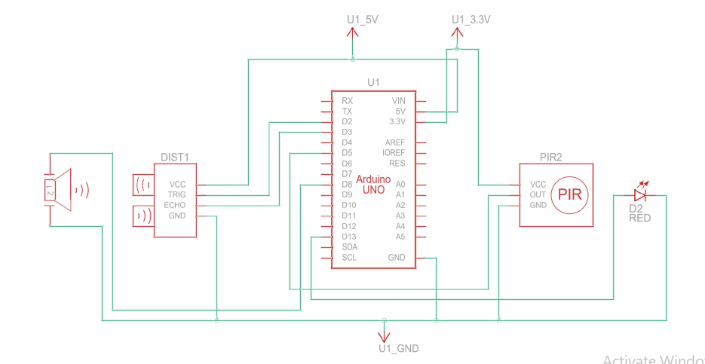
Schematic view of final circuit

Slide 14
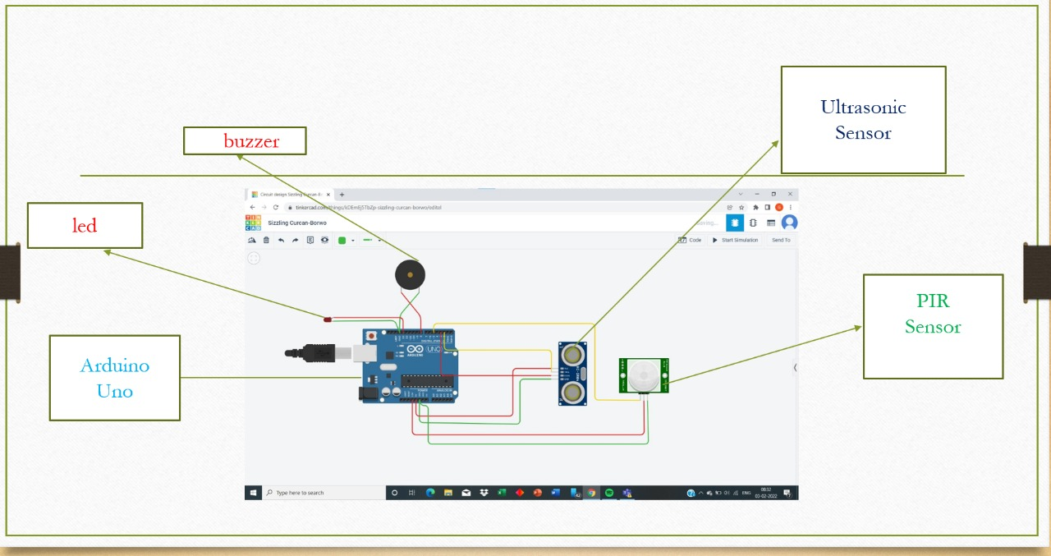
Circuit View

Slide 15
Final code
int LED = 13;
int PIR = 5; int const trigPin = 2;
int const echoPin = 3;
int const buzzPin = 8;
void setup() {
pinMode(LED, OUTPUT);
pinMode(PIR, INPUT);
pinMode(LED_BUILTIN, OUTPUT);
pinMode(trigPin, OUTPUT);
pinMode(echoPin, INPUT);
pinMode(buzzPin, OUTPUT);
Serial.begin(9600);
}
void loop(){
if (digitalRead(PIR) == HIGH) {
digitalWrite(LED, HIGH);

Slide 16
digitalWrite(LED_BUILTIN, HIGH);
Serial.println("Motion detected!");
delay(10);
}
else {
digitalWrite(LED, LOW);
digitalWrite(LED_BUILTIN, LOW);
Serial.println("Motion stopped!");
delay(10); }
int duration, distance;
digitalWrite(trigPin, HIGH);
delay(1);
digitalWrite(trigPin, LOW);
duration = pulseIn(echoPin, HIGH);
distance = (duration/2) / 29.1;

Slide 17
if (distance <= 50 && distance >= 0) {
digitalWrite(buzzPin, HIGH);
} else {
digitalWrite(buzzPin, LOW);
}
delay(60);
}

Slide 18
What we could achieve and what was left out
We could achieve the basic idea behind goal line technology and make the project work
Also the distance between the ball and the goal line could have achieved by using camera/screen feature but could not do so due to lack of machine learning knowledge and budget issues.
It was also planned to make a separate goal post and fix the sensors in it but in the end we decided to use a square study table for the project , but it served the same purpose of acting as a goal post.

Slide 19
Difficulties faced
PIR sensor becomes inefficient when object is moving fast.

Slide 20
Thank You!

